Slide 1
CEPS Low Cost Low Output

Slide 2
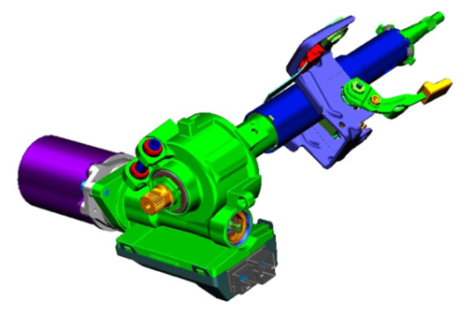
CEPS Low Cost Low Output
Motivation (5)
Description
A CEPS assembly for low torque applications (<45 Nm) which employs brushless motor technology and exploring higher worm/gear ratio.
Motivation
Reduce FTQ noise issues seen with current brush motor of low output CEPS
Reduce CEPS brushless assist assembly cost (<= to brush system)
Deliverables
Phase 1- minimum 28:1 ratio investigation and verification
Design and develop initial prototype system
Performance results: bench (and vehicle)
Phase 2- System configuration / architecture concepts and selection
Initial Cost/MSD
Timing (Phase 1)
Concept development and analysis / Selection: June 2014
Concept design and build complete: October 2014
Testing complete / Feasibility decision: December 2014
Team Members/Customers
Brian Magnus, Jeff Beyerlein, David King, Steve Collier-Hallman

Slide 3
Status
Study of multiple worm gear designs completed
Minimum of 28:1 ratio
Packaging size (goal to fit in current 15:1 or 22:1 package)
Gear pattern analysis
Load capacity analysis
Three designs chosen to build and evaluate
28:1, 43.75 mm CD (SGMW), 80.21 mm OD (slightly larger than SGMW), 11 mm wide
30:1, 43.75 mm CD (SGMW), 80.27 mm OD (slightly larger than SGMW), 14 mm wide
31:1, 52.00 mm CD (Gamma), 95.92 mm OD (slightly larger than Gamma), 11 mm wide
Prints for gear hobs, worm shaft blanks, worm shafts, and gears are complete and are either at quoting or ordered
Worm gear efficiency impact on system analysis in process
LA is 16 instead of 19; Approximately 3% reduction in efficiency for new high ratio concepts
NVH running noise test set-up design complete; drawings in process

Slide 4
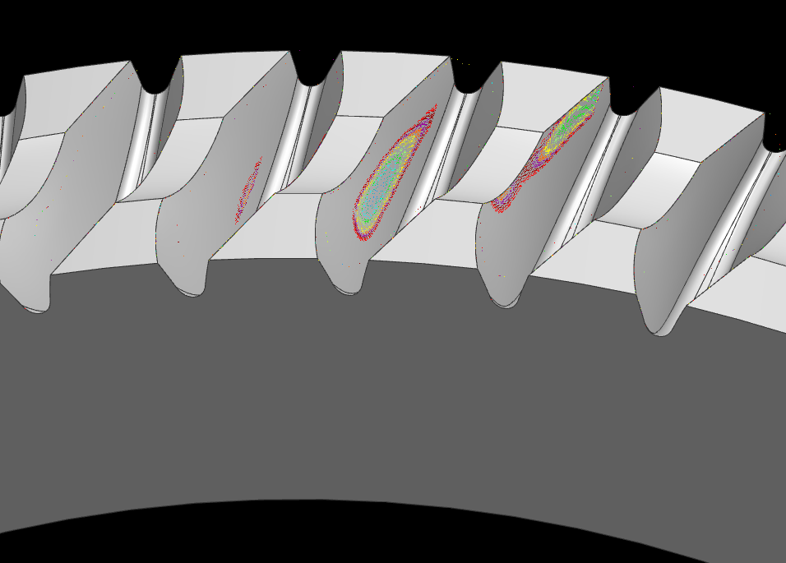
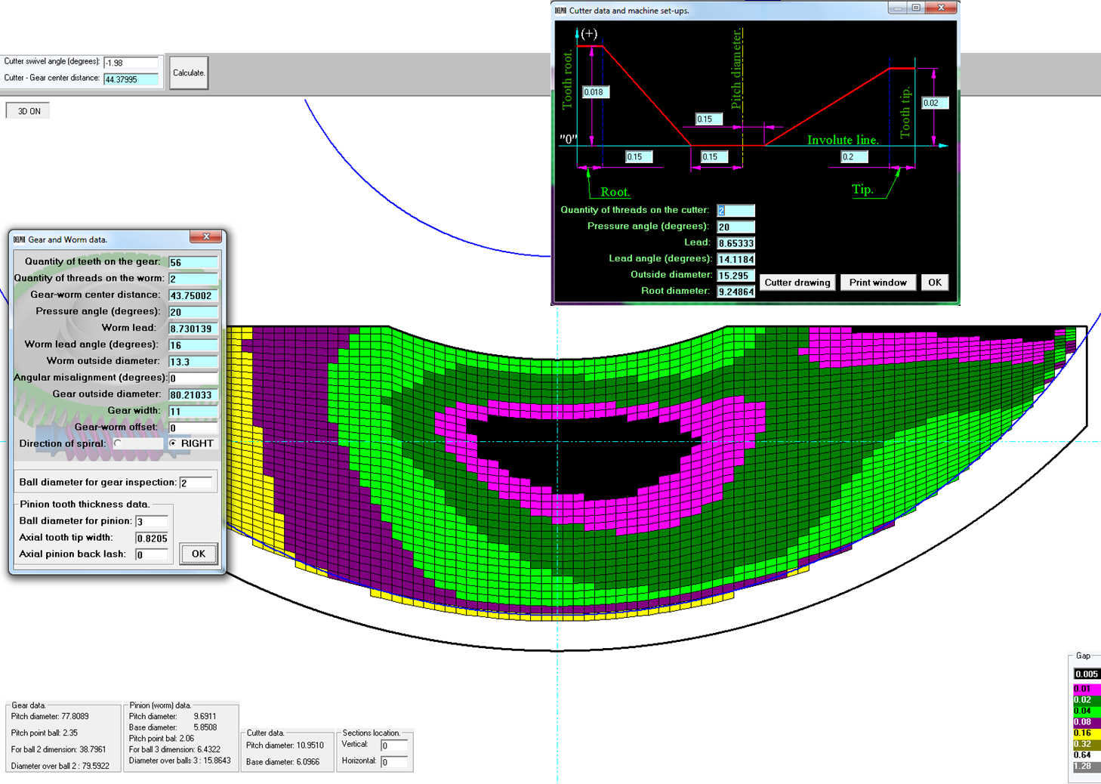
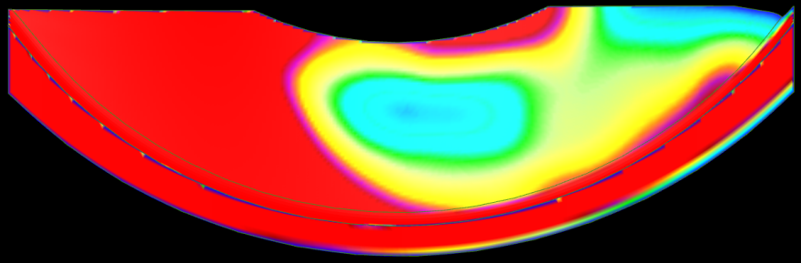
Concept 28H
Gear Ratio: 28:1
Gear Width: 11mm
Gear OD: 80.21mm
Center Distance: 43.75mm

Slide 5
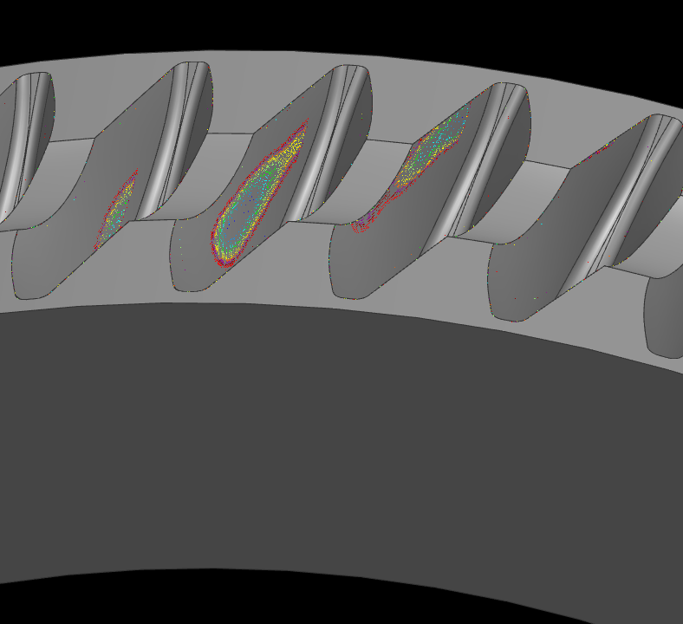
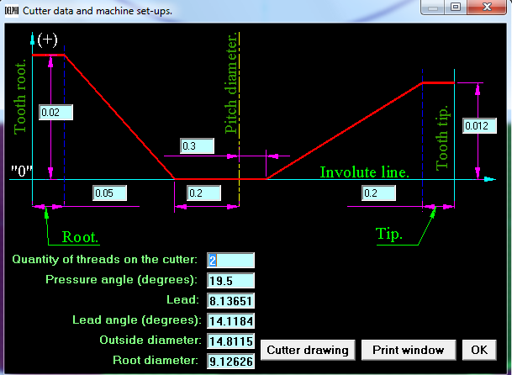
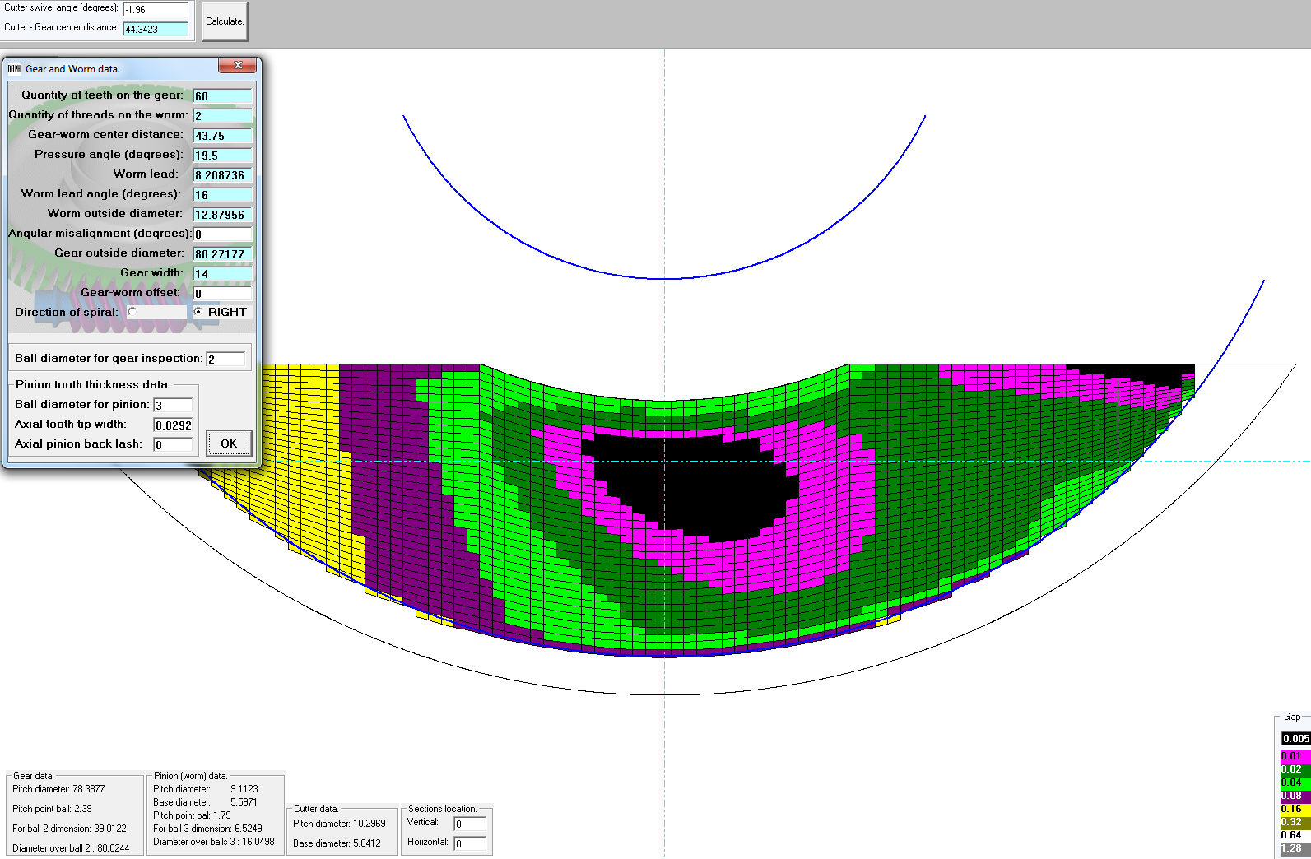
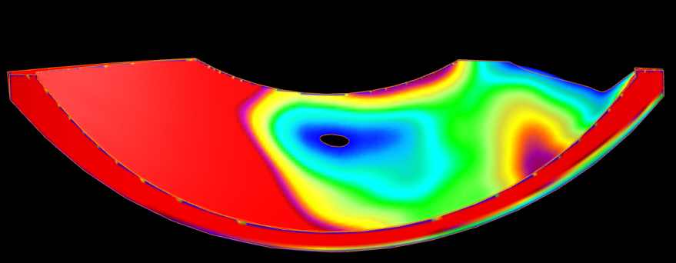
Concept 30D
Gear Ratio: 30:1
Gear Width: 14mm
Gear OD: 80.27mm
Center Distance: 43.75mm
Try initially at 14 mm wide then potentially try width reduction by beveling or thinning

Slide 6
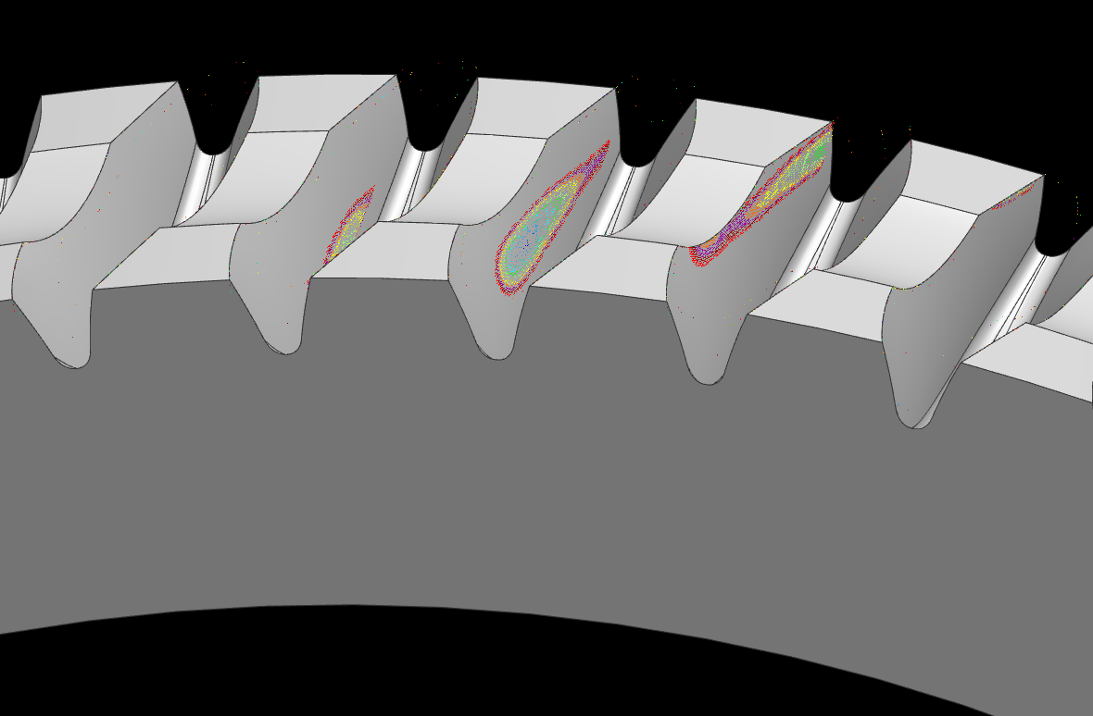

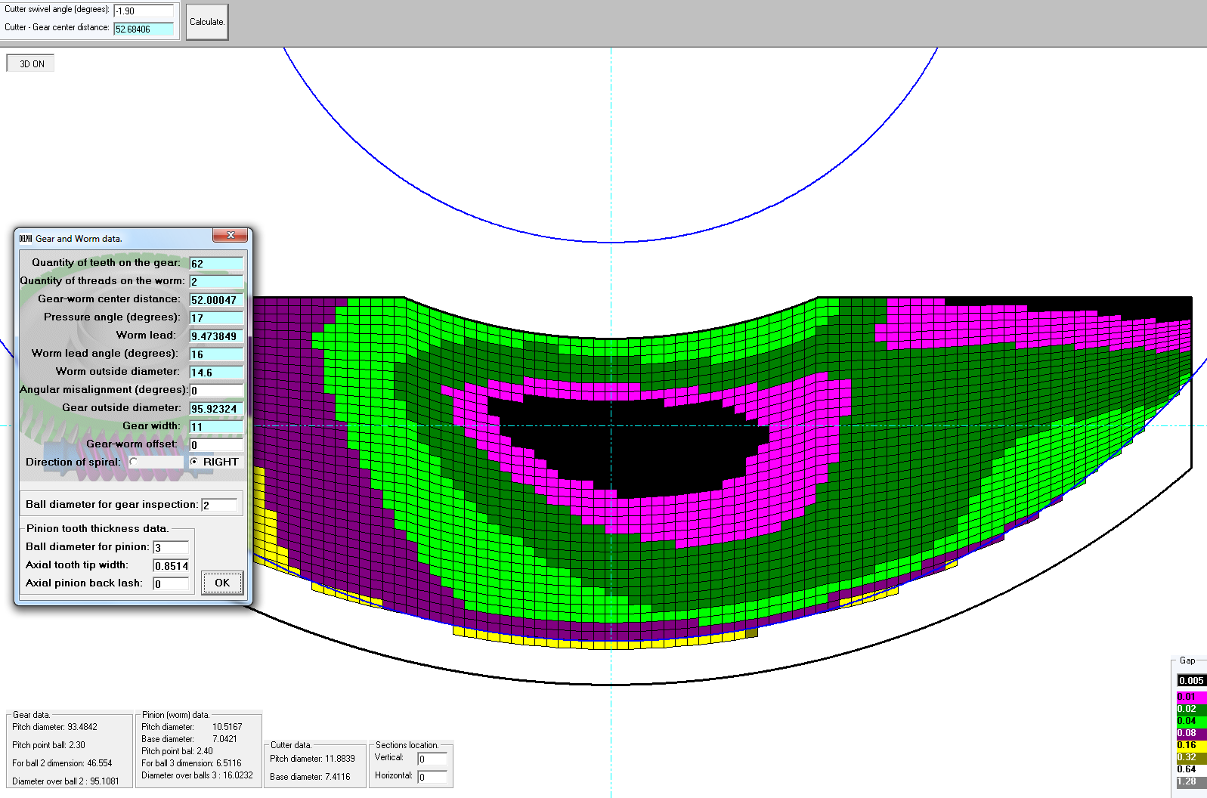
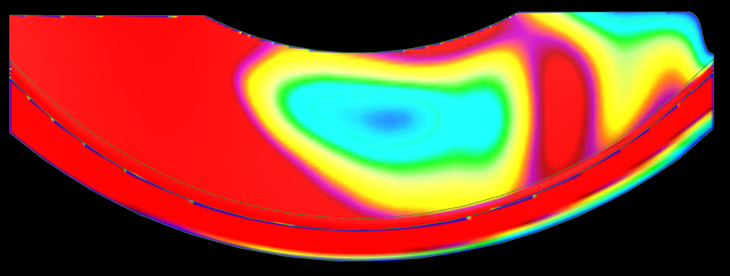
Concept 31A
Gear Ratio: 31:1
Gear Width: 11mm
Gear OD: 95.92mm
Center Distance: 52.00mm

Slide 7
Prototype Evaluation & Testing Plan
Worm and gear part CMM dimensional inspections
Contact pattern checks
Backdrive Zoning curve development - torque vs worm sizing
4 zones; 3 worms each zone (zones 6,7,8,9)
Gear swivel angle iteration: design value, +0.2, -0.2, -0.4
Lash measurement
Forward Efficiency
Running noise (NVH lab)
Full assist mech acoustic noise test
Gear only assist mech structural noise test
Wear and bottoming; use current SGMW low output profile stopping at increments to evaluate backdrive, lash, running noise, FDR?
FDR – TBD
Potential vehicle testing on Gamma for 31:1 design; 28:1 and 30:1 TBD vehicle

Slide 8
Project Timetable Estimates
Parts order for remaining prototype parts July 21
(Hobs long lead 8 weeks)
Complete NVH test stand fixture drawings Aug 1
Parts order for NVH fixtures Aug 4
Parts order for SGMW and Haitec misc parts for testing Aug 11
Concepts and analysis of Phase 2 CEPS system elements On-going
Bearing, interface, and mounting configurations
Motor and controller
sensors
All parts completed / received by this date October 1
Begin testing of 3 designs October 6
Finish testing evaluation of first 3 worm gear designs December 8
High ratio feasibility decision December 10

